Slide 1
Spatial Databases

Slide 2
What is a Spatial Database?
A SDBMS is a DBMS
It offers spatial data types/data models/ query language
Support spatial properties/operations
It supports spatial data types in its implementation
Support spatial indexing, algorithms for spatial selection and join

Slide 3
Spatial DataBases
The contents of a spatial data base present a particular view of the world.
The user of the spatial data base sees the real world through the medium of the data base, therefore the measurements and samples contained in the data base must be maintained as complete and accurate as possible to present a view of the real world.
The contents of a spatial database are special in terms of:
themes and characteristics captured (attributes),
the time period covered, and
the study area (spatial entities)

Slide 4
Spatial Representation
Raster
Images
Point
Spatial
Line
Polygon
Vector
Non- Spatial
Attribute

Slide 5
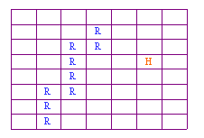
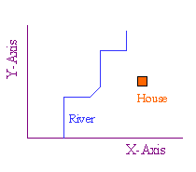
Spatial Representation
Raster model:
Vector model:

Slide 6
Spatial data types
point
region
line
Point : 2 real numbers
Line : sequence of points
Region : area included inside n-points

Slide 7
Spatial Data Model: Basic Data Types
2 basic spatial data models exist
vector: based on geometry of
points
lines
Polygons
raster: based on geometry of
grid cells (images, bitmaps, DEMs)

Slide 8
Vector Data

Slide 9
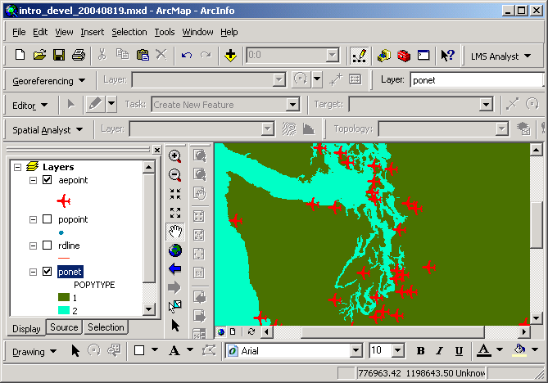
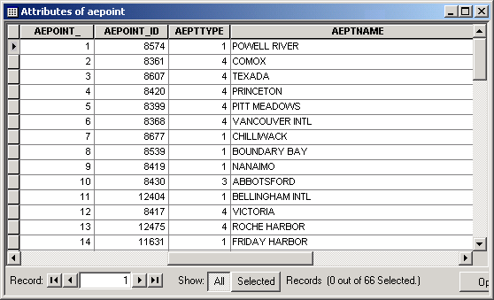
Vector Data Model
Points: represent discrete point features
each point location has a record in the table
airports are point features
each point is stored as a coordinate pair

Slide 10
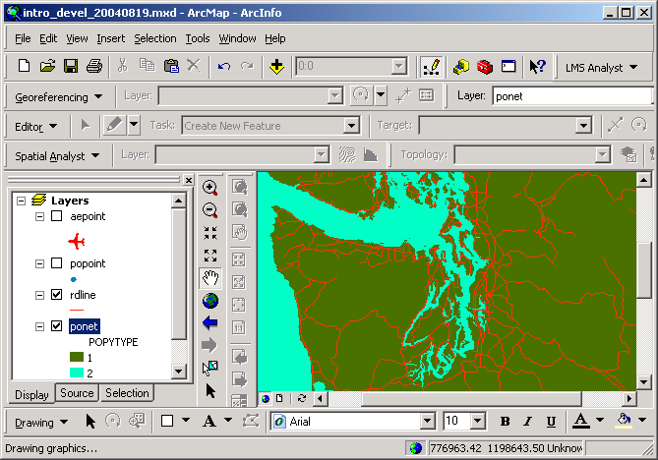
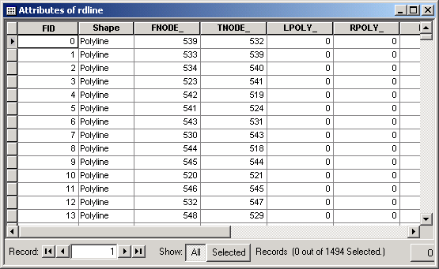
Vector Data Model
Lines: represent linear features
each road segment has a record in the table
roads are linear features

Slide 11
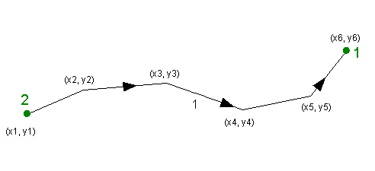
Vector Data Model
node
vertex
vertex
vertex
node
vertex
Lines start and end at nodes
line #1 goes from node #2 to node #1
Vertices determine shape of line
Nodes and vertices are stored as coordinate pairs

Slide 12
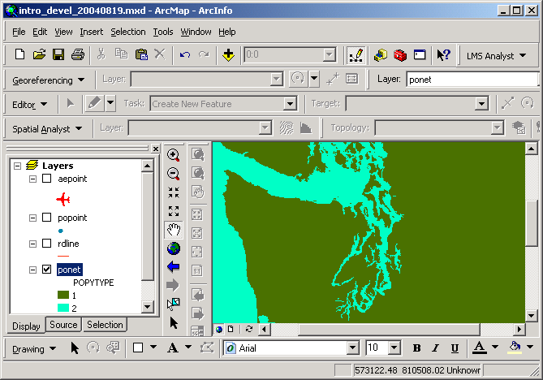
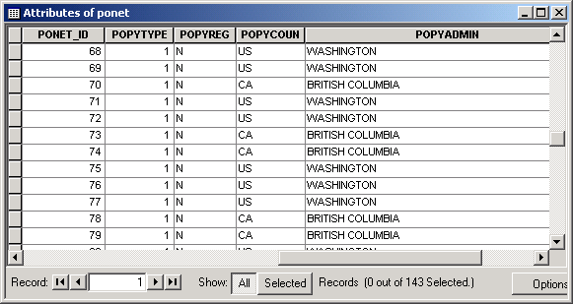
Vector Data Model
Polygons: represent bounded areas
each bounded polygon has a record in the table
landforms and water are polygonal features

Slide 13
Vector Data Model
Points are discreet
Nodes
Vertices
Lines
Nodes
Vertices
Arcs
Closed area (Lines + points ) = polygons

Slide 14
Vector Data Model
Vector data formats available in ArcGIS
ESRI GeoDatabases
ESRI shapefiles
ArcInfo coverages and libraries
CAD files (AutoCAD DWG, DXF; microstation DGN)
StreetMap files
Spatial Database Engine (SDE) data
ASCII point coordinate data
Linear measure (route) data

Slide 15
Vector Data Model
ESRI Geodatabases
Geodatabase can store many files from many source formats
1st preferred vector format in ArcGIS
Rapid display
Fully editable (coordinate and tabular) in ArcGIS
Convenient storage format
Data sets are either point or line or polygon

Slide 16
Vector Data Model
ESRI shapefiles
2nd preferred vector format in ArcGIS
Rapid display
Fully editable (coordinate and tabular) in ArcGIS
Simple in structure
Do not use arc-node topology
“Connected” lines do not necessarily share a common node
Adjacent polygons do not share common bounding arcs
Data sets are either point or line or polygon

Slide 17
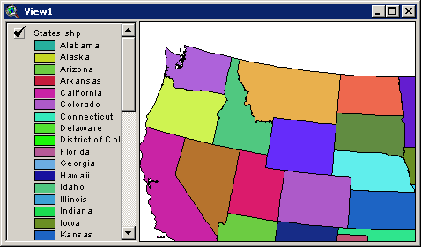
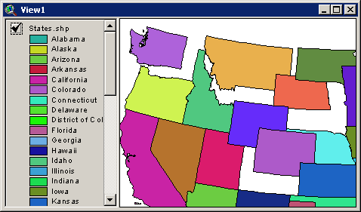
Vector Data Model
Shapefile polygon spatial data model
less complex data model
polygons do not share bounding lines

Slide 18
Vector Data Model
ArcInfo coverages
Commonly found format (due to ArcInfo market dominance)
Data model more complex
Display more slowly in ArcGIS
Coordinate data not editable in ArcGIS
Polymorphic (point/line/polygon/route/annotation/…)
Problematic OS file structure

Slide 19
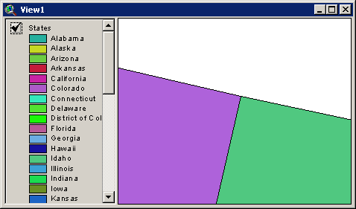
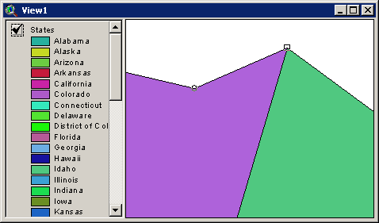
Vector Data Model
ArcInfo coverage spatial data model
polygons share bounding lines
same topological rules can be built into Geodatabase

Slide 20
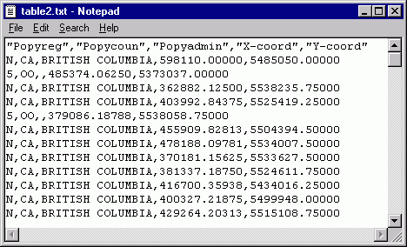
Vector Data Model
ASCII coordinate data
Easy to obtain from a variety of sources
GPS
Traverse (survey)
Direct reading
OS and application independent

Slide 21
Vector Data Model
Characteristics
+ Features are positioned accurately
+ Shape of features can be represented correctly
+ Features are represented discretely (no fuzzy boundaries)
– Not good for representing spatially continuous phenomena
– Potentially complex data structure (especially for polygons);
- can lead to long processing time for analytical operations

Slide 22
Raster Data

Slide 23
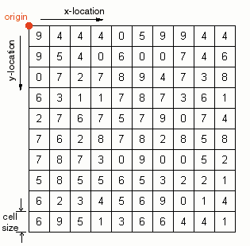
Raster Data Model
origin is set explicitly
cell size is always known
cell references (row/column locations) are known
cell values are referenced to row/column location
values represent numerical phenomena or index codes for non-numerical phenomena

Slide 24
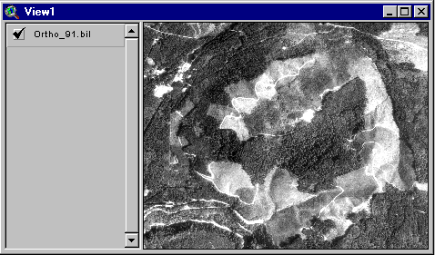
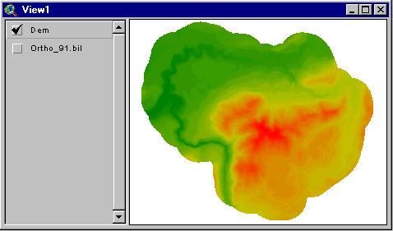
Raster Data Model
A few different types of raster data
digital orthophoto
digital elevation model (DEM)

Slide 25
Spatial Relationships
Topological relationships:
adjacent, inside, disjoint, etc
Direction relationships:
Above, below, north_of, etc
Metric relationships:
“distance < 100”
And operations to express the relationships

Slide 26
The contents of a spatial data base include:
Digital versions of real objects (e.g. lakes),
Digital versions of artificial map features (e.g. contours),
Artificial objects created for the purposes of the data base (e.g. pixels).

Slide 27
Components of Spatial Data
Time:
The temporal mode can be captured in several ways: - by specifying the interval of time over which an object exists, - by capturing information at certain points in time, or - by specifying the rates of movement of objects.
Depending on how the temporal mode is captured, it may be included in a single attribute table, or be represented by series of attribute tables on the same objects through time.
Spatial data model, query language, query processing, file organization and indices, query optimization, etc.

Slide 28
Scales (Levels) of Measurement
Numerical values may be defined with respect to nominal, ordinal, interval, or ratio scales of measurement (or levels of measurement). It is important to recognise the scales of measurement used in spatial data as this determines the kinds of mathematical operations that can be performed on the data.
The different scales can be demonstrated using an example of a marathon race.

Slide 29
SPATIAL RELATIONS
Relations exist between spatial objects like distance, proximity, nearness, contained in etc.
 | Points | Lines | Areas
Points | is a neighbour of is allocated to | is near to lies on | is a centroid of is within
Lines |  | crosses joins | intersects is a boundary of
Areas |  |  | is overlaid by is adjacent to

Slide 30
Examples
A database:
Relation states(sname: string, area: region, spop: int)
Relation cities(cname: string, center: point; ext: region)
Relation rivers(rname: string, route:line)
SELECT * FROM rivers WHERE route intersects R
SELECT cname, sname FROM cities, states WHERE center inside area
SELECT rname, length(intersection(route, California)) FROM rivers WHERE route intersects California

Slide 31
Spatial Queries
Selection queries: “Find all objects inside query q”, inside-> intersects, north
Nearest Neighbor-queries: “Find the closets object to a query point q”, k-closest objects
Spatial join queries: Two spatial relations S1 and S2, find all pairs: {x in S1, y in S2, and x rel y= true}, rel= intersect, inside, etc

Slide 32
Indexing using SAMs
Approximate each region with a simple shape: usually Minimum Bounding Rectangle (MBR) = [(x1, x2), (y1, y2)]
G-tree indexing
B-Tree indexing
y2
y1
x1
x2

Slide 33
Three Layer Architecture

Slide 34
Applications
Solid waste management
Slum area detection
Detection of Buildings
Finding shortest path from trajectory dataset
Detection of airport
Prediction of a location for starting a school
Malaria prone area detection
Road extraction

